Slide 1
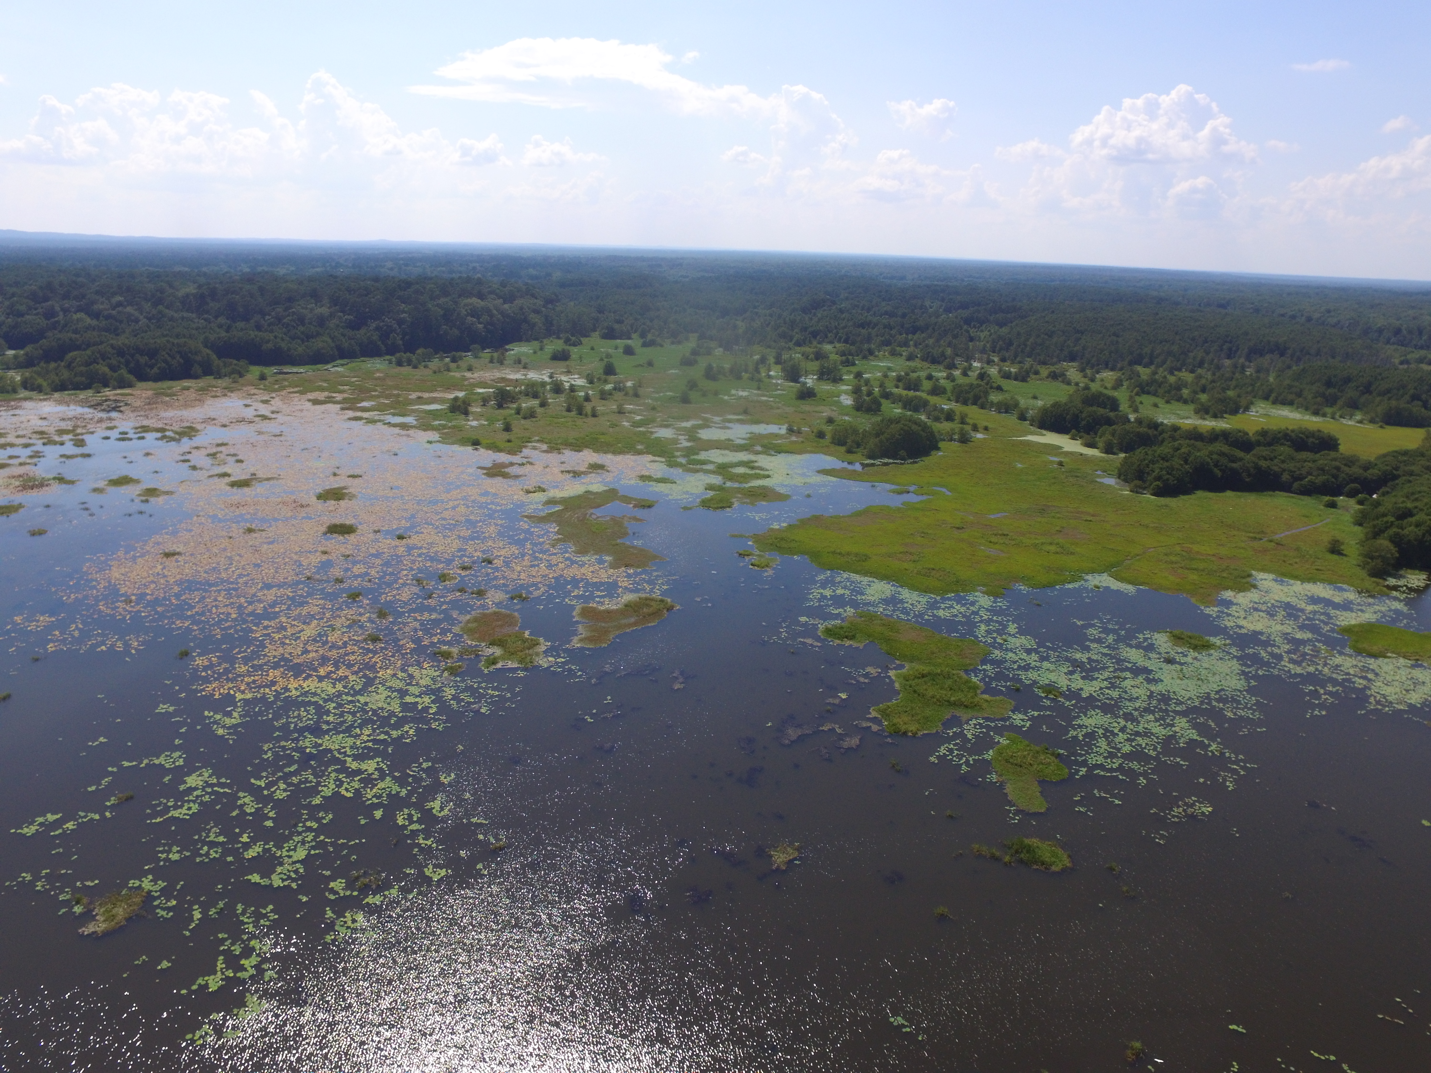
Bluff Lake Hydrology

Slide 2
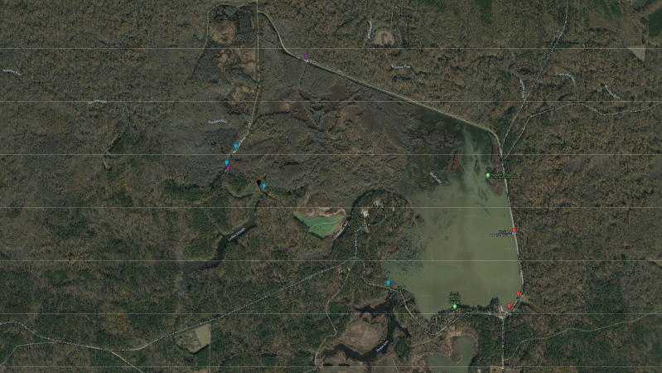
Notch 2
Notch 1
Water Control Structure 2
Bridge 2
Bridge 1
Water Control Structure 1
Emergency Spillway

Slide 3
INFLOW

Slide 4
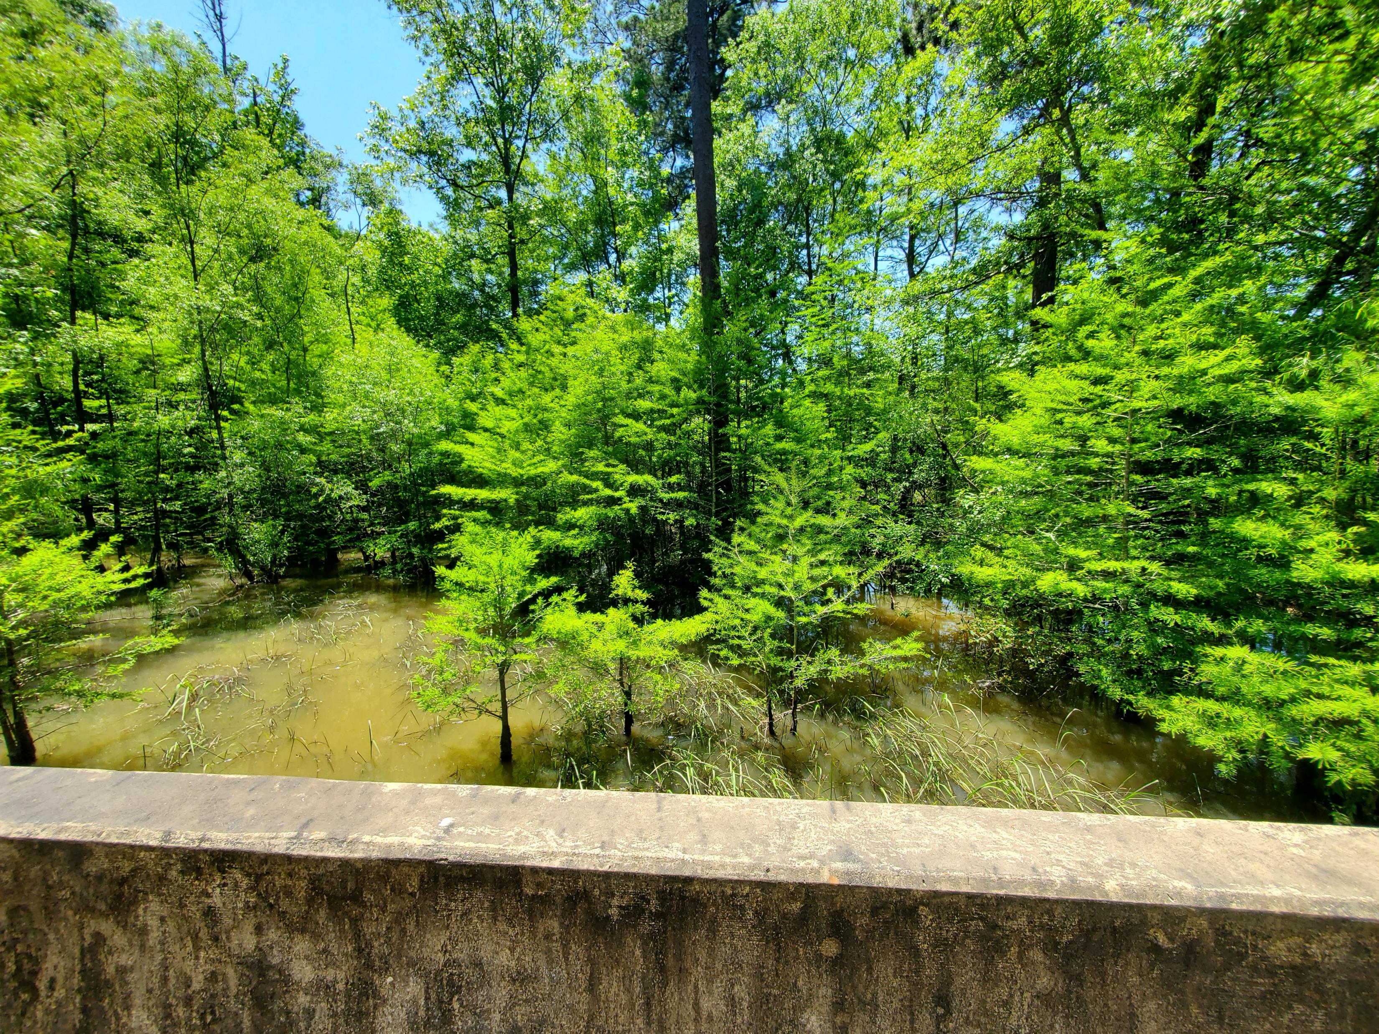


Bridge 1
Griffin Slough
This bridge has continuous and unregulated inflow into Bluff Lake from Griffin Slough. This feature, along with WCS 2 make up the bulk of inflow into Bluff Lake at low flows.
Width of Bridge notch- 23.3 m
Bluff Lake

Slide 5
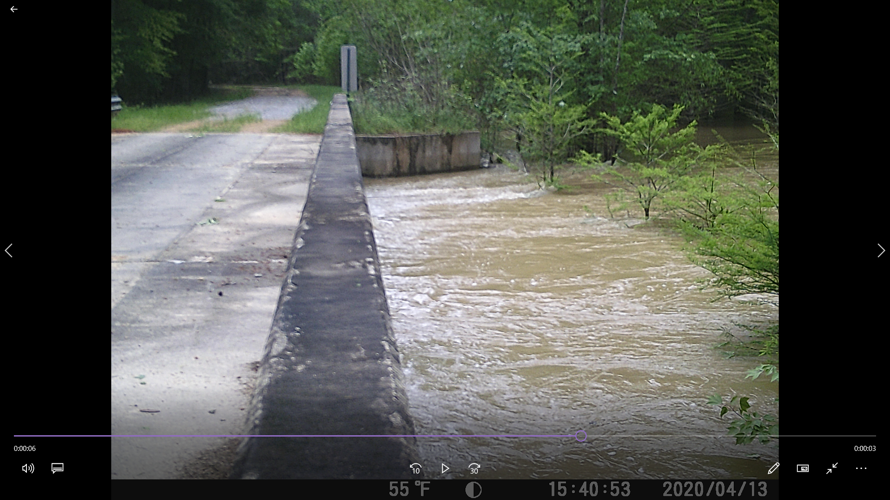
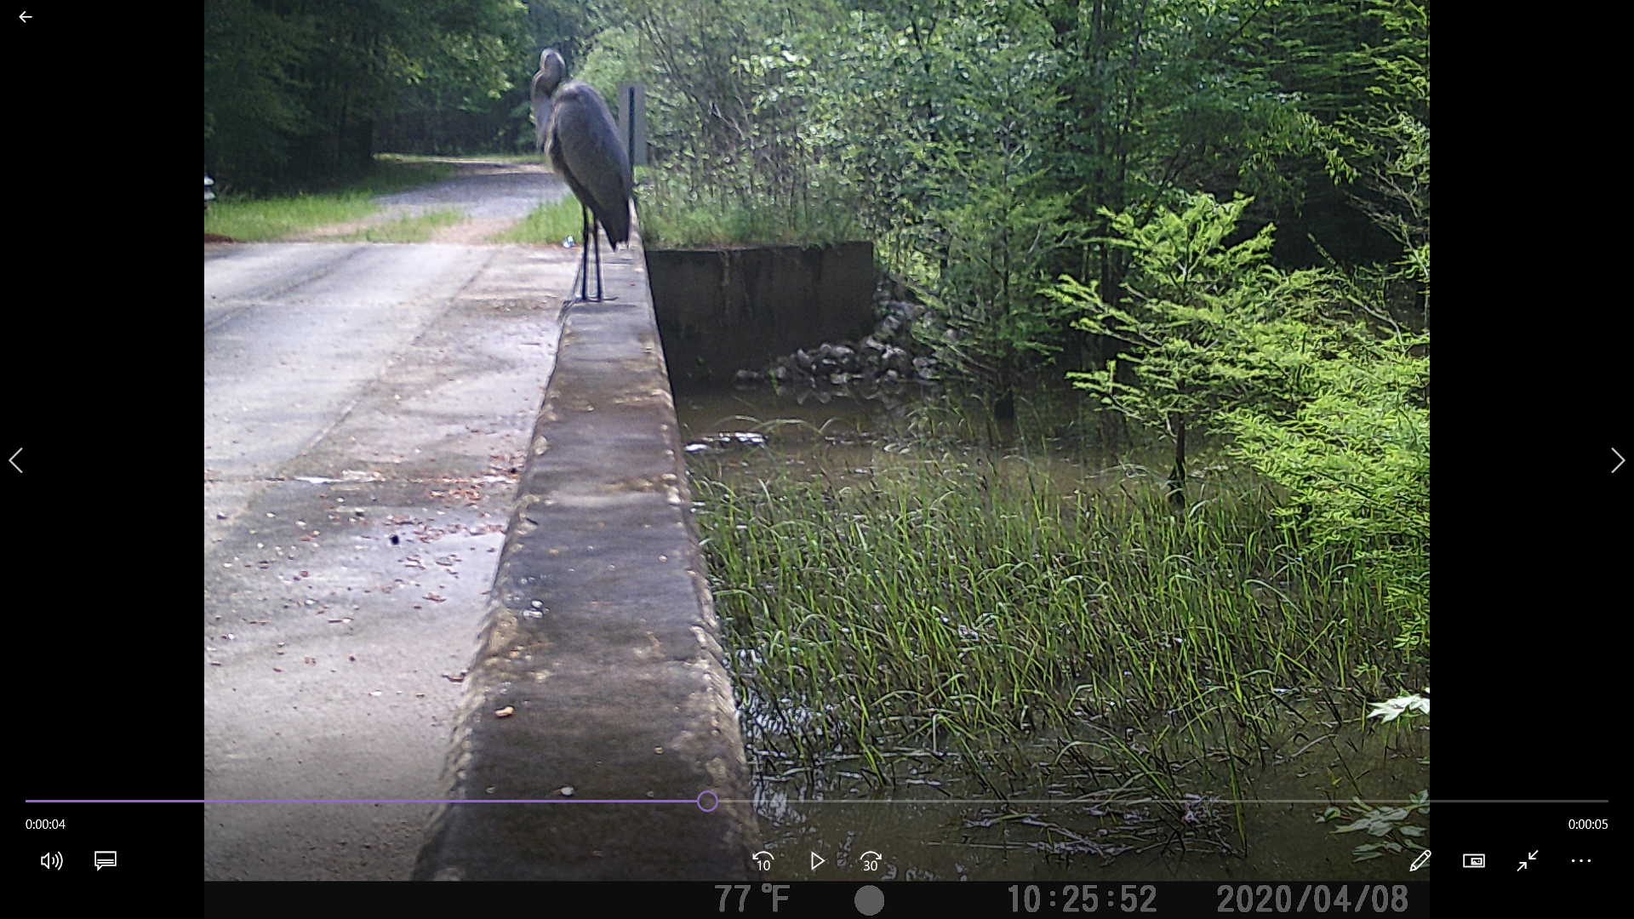
Bridge 1
Lake Elevation: 68.771
Noxubee Discharge: 6,200 cfs
Lake Elevation: 68.248
Noxubee Discharge: 2,220 cfs
Griffin Slough
Griffin Slough

Slide 7
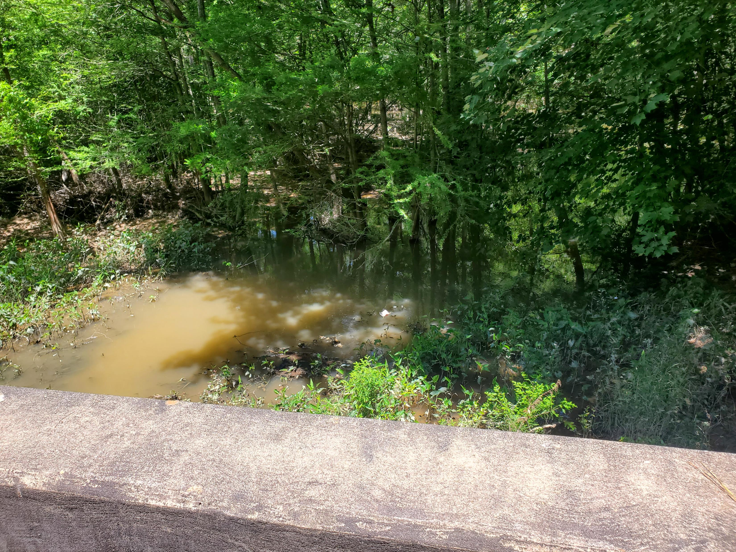
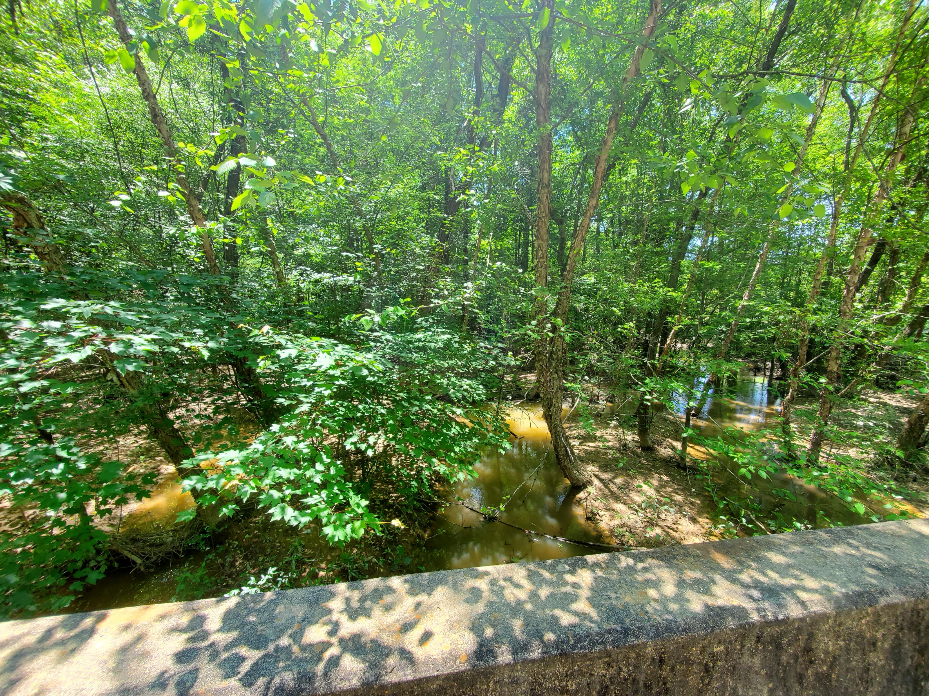
Bridge 2
Noxubee River
After large rain events water flows into Bluff Lake. As lake levels rise and the Noxubee River lowers, water begins to flow outward towards the Noxubee River. This area is crossed with shallow pools and small stream-like features. This area could potentially dry during summer months.
Width of Bridge: 21.2 m
Bluff Lake

Slide 8
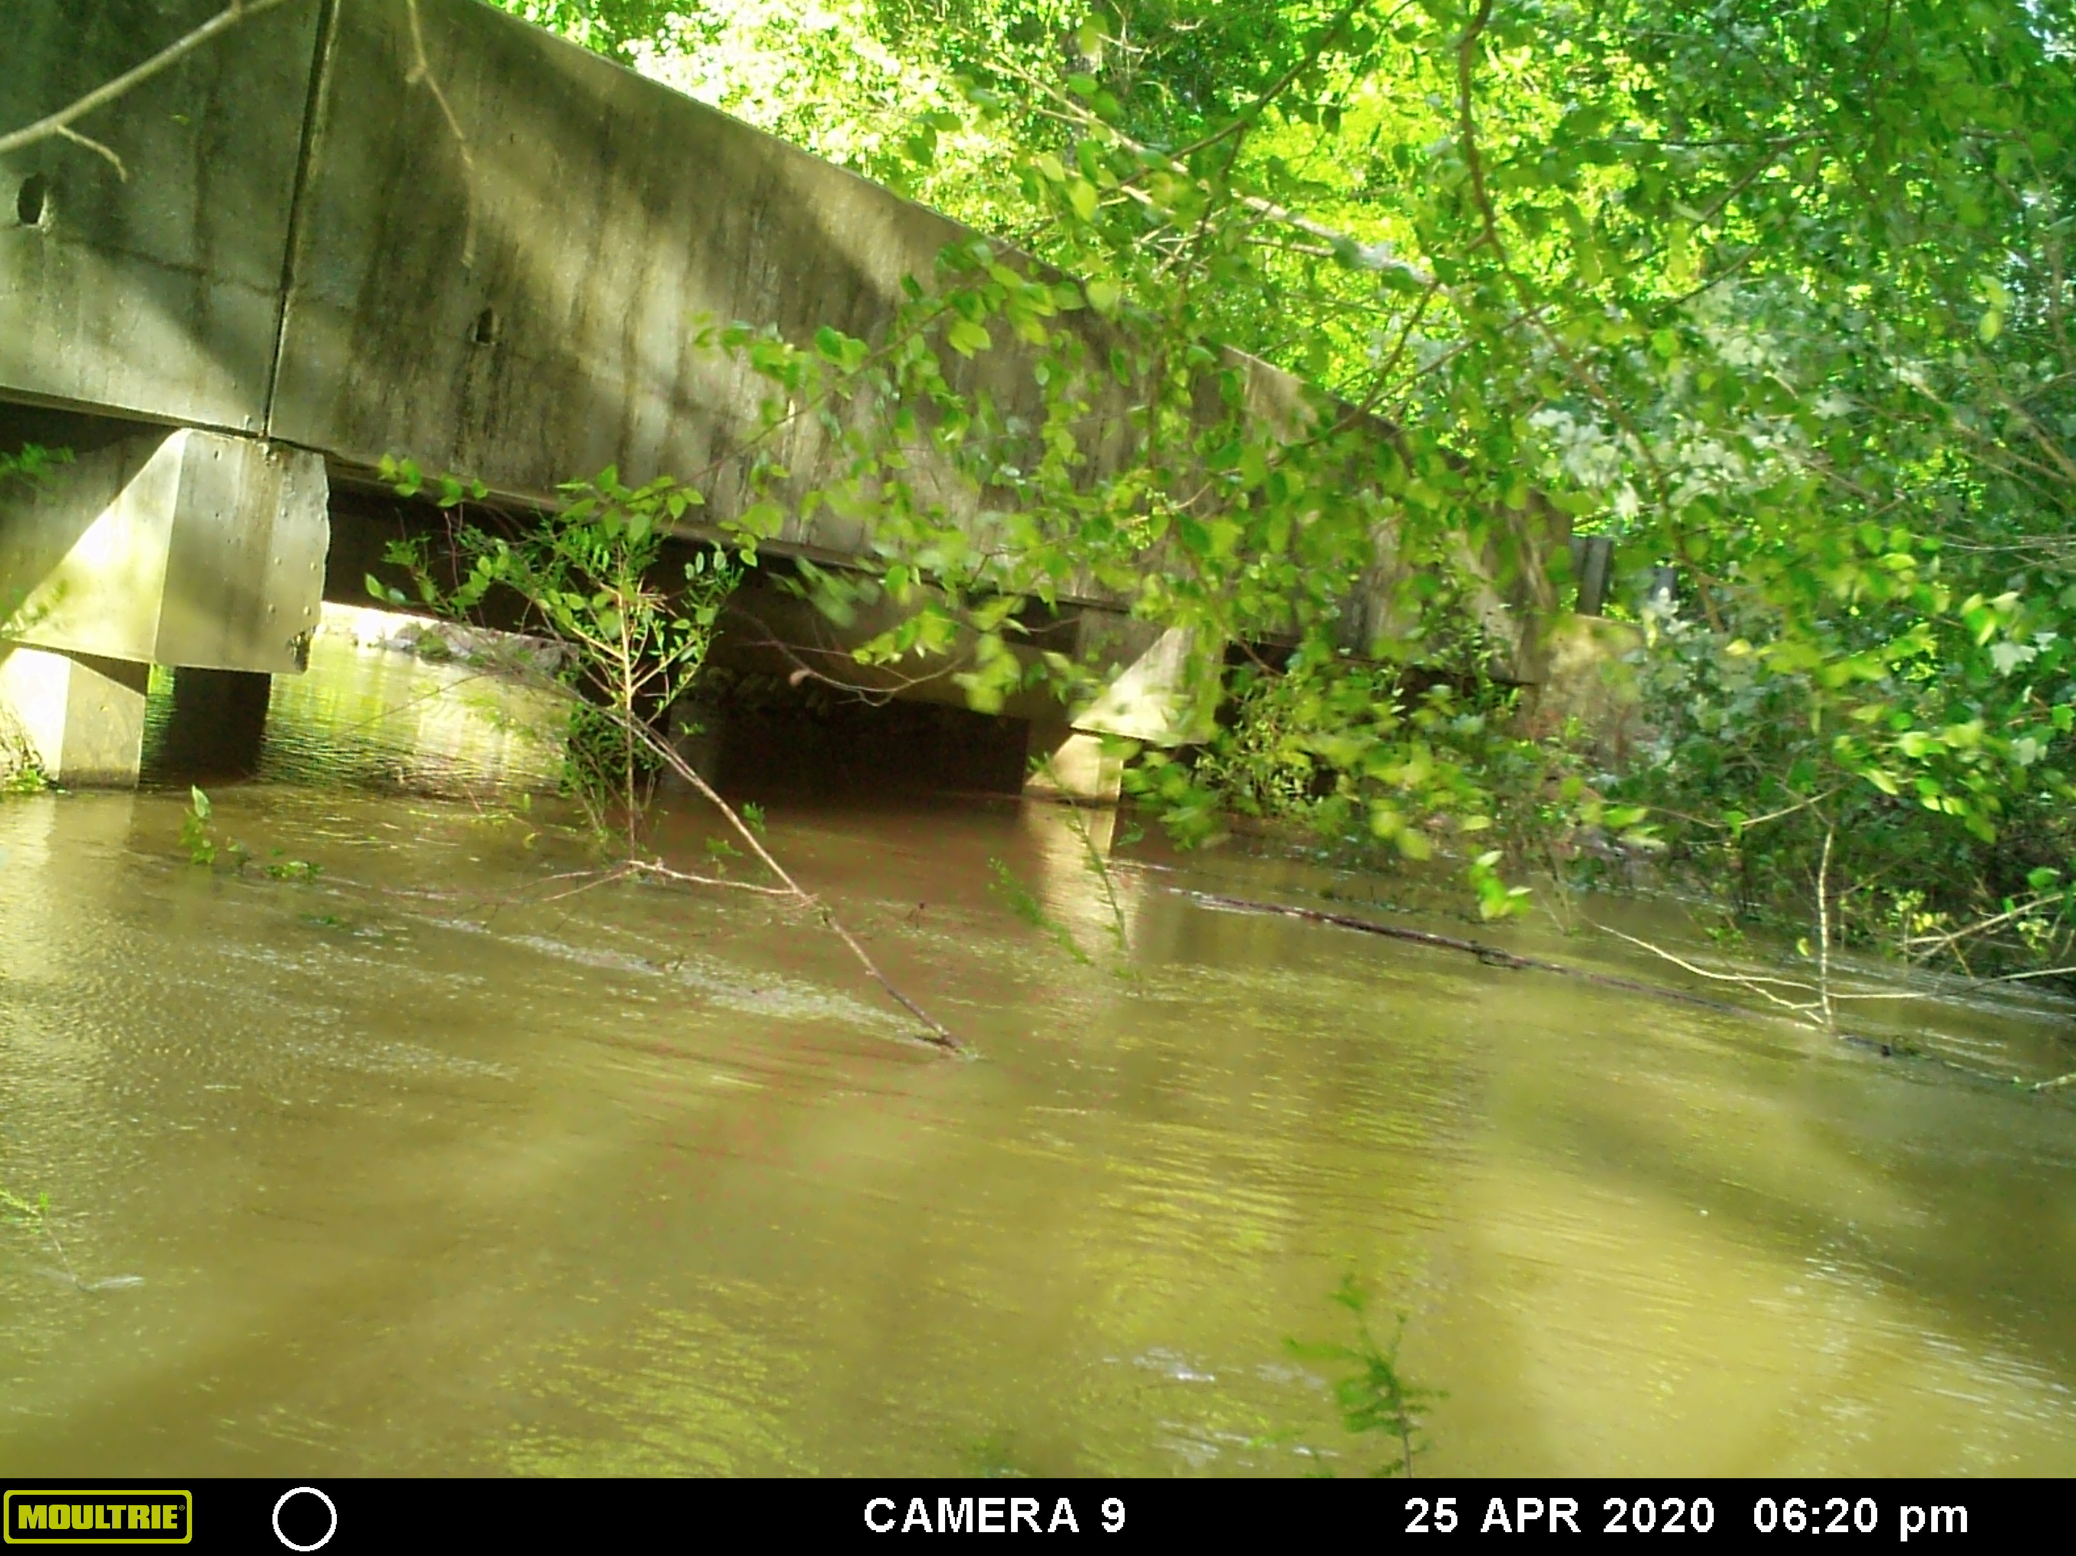
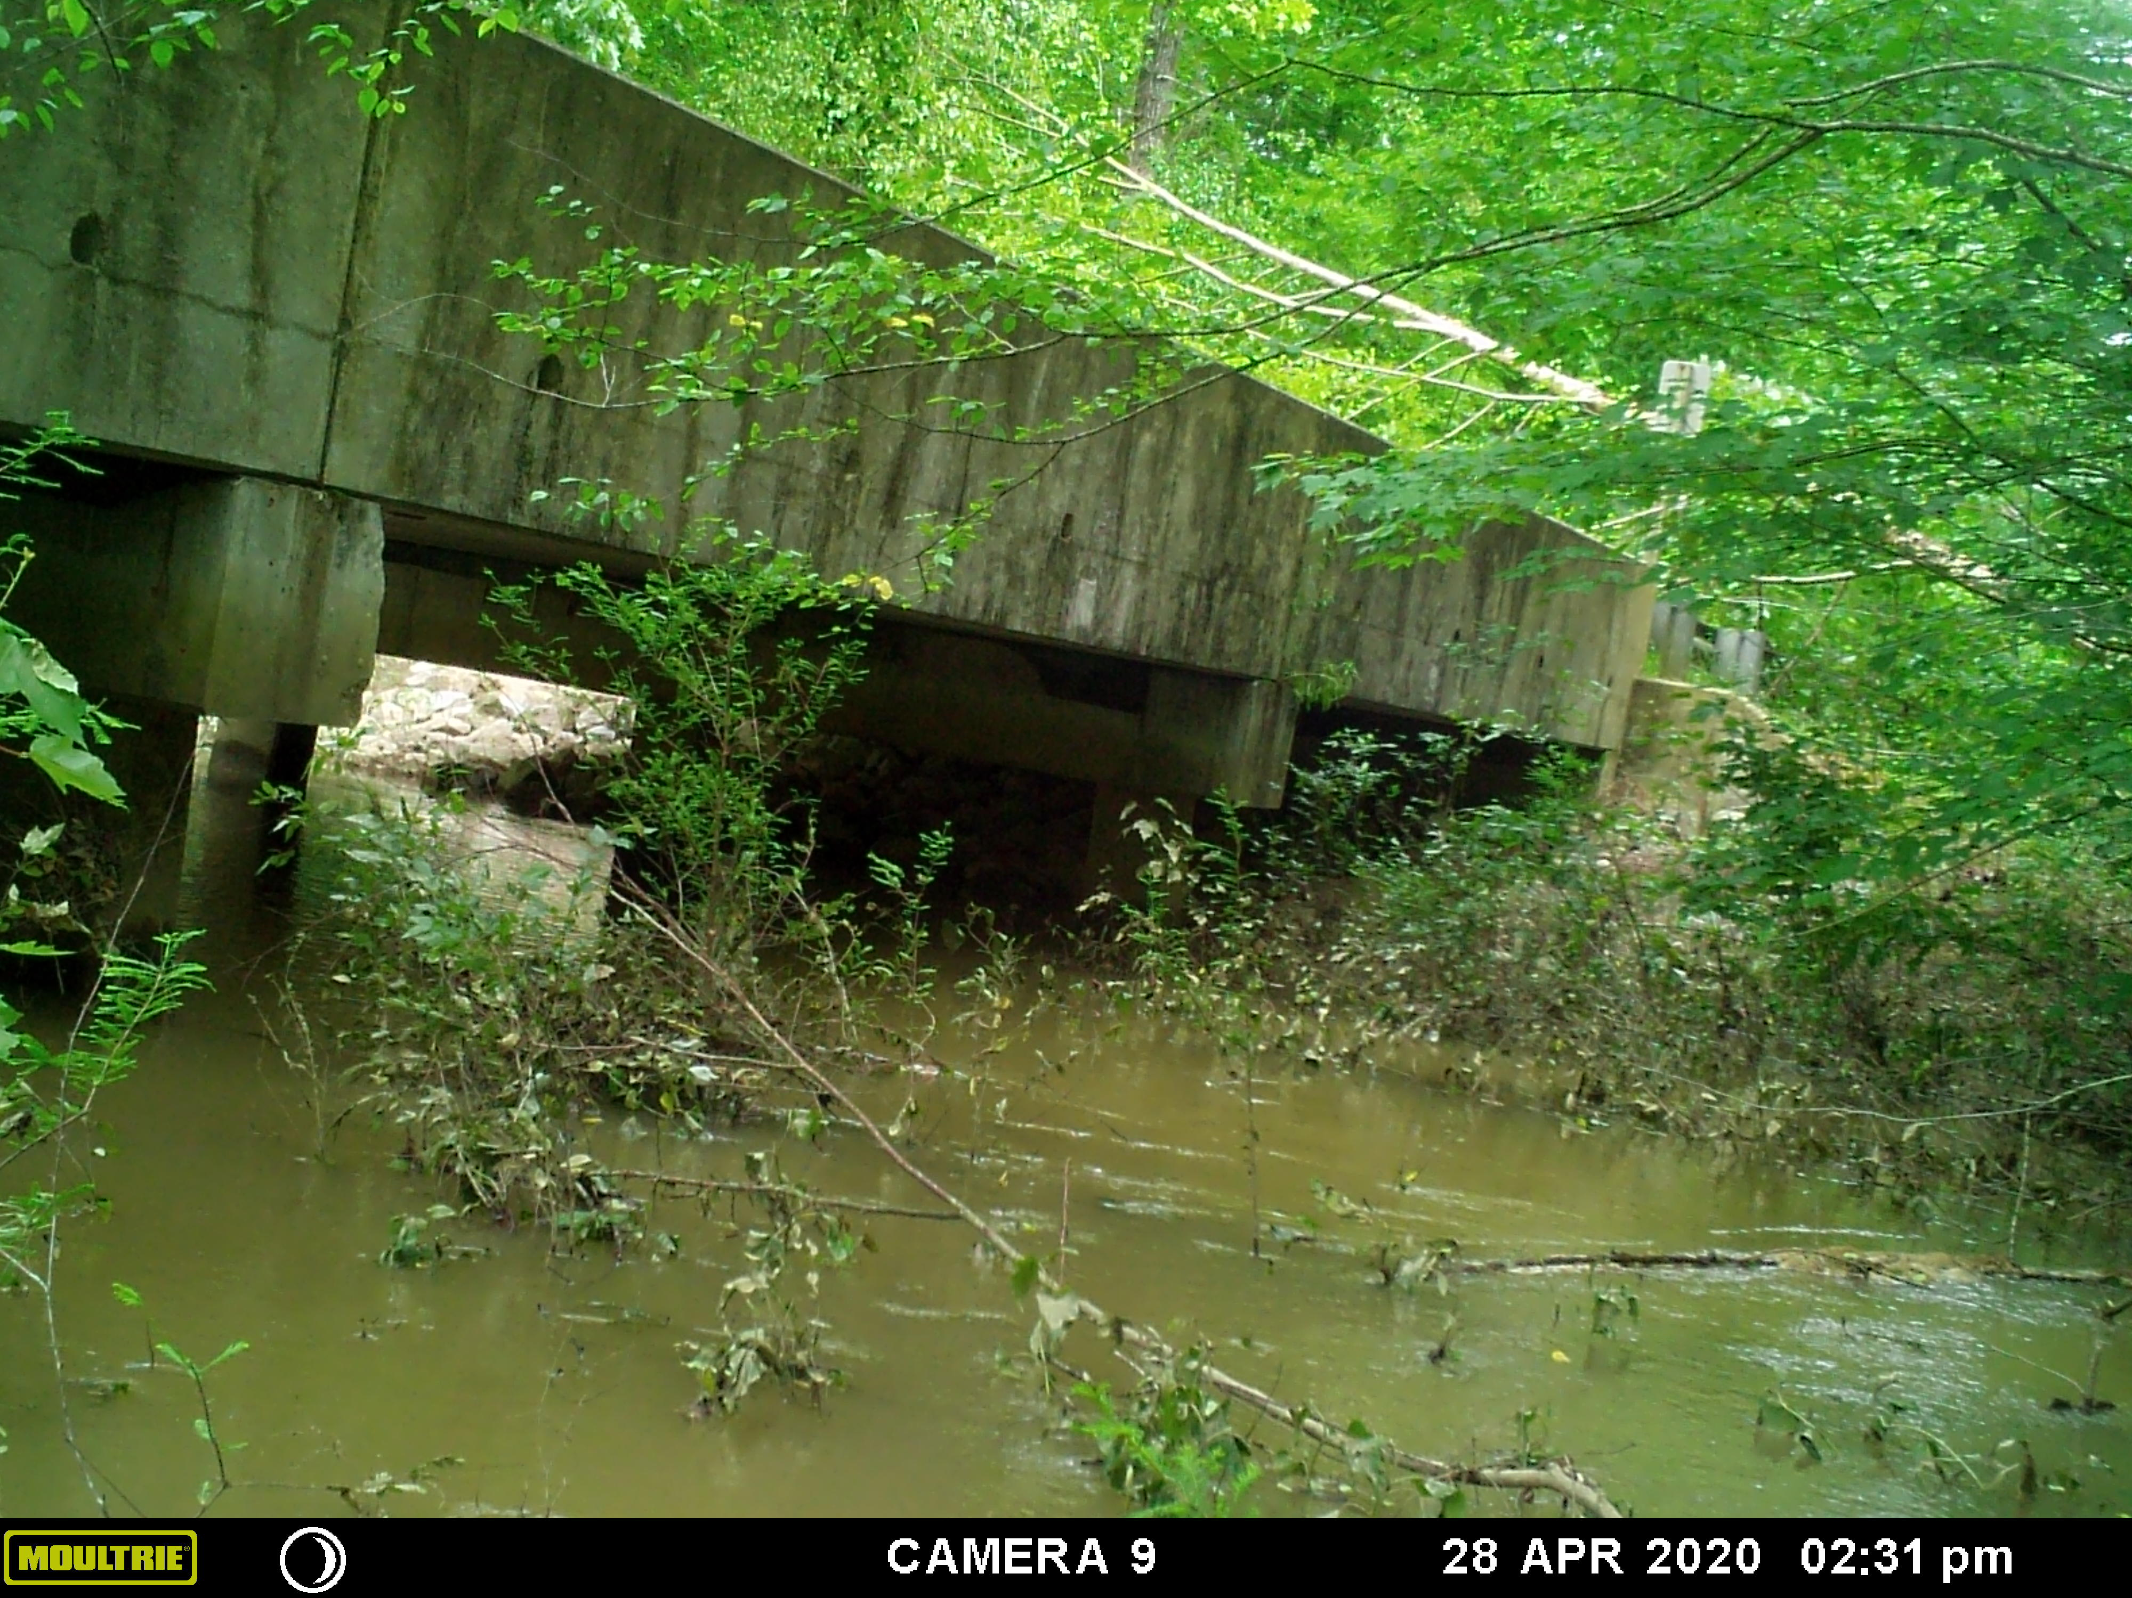
Bridge 2
Flow into Bluff Lake
Lake Level Elevation: 68.643
Noxubee Discharge: 9,380 cfs
Flow out of Bluff Lake
Lake Level Elevation: 68.486
Noxubee Discharge: 4,650
Noxubee River
Noxubee River

Slide 10
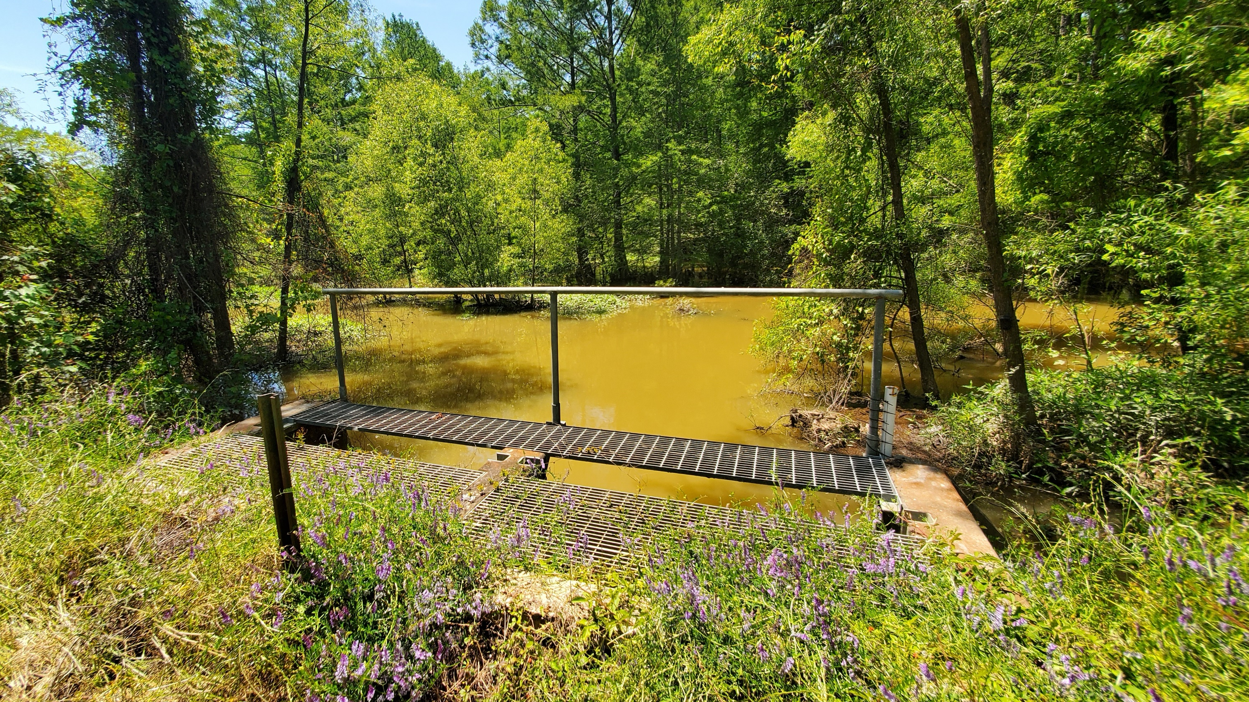
Noxubee River
Water Control Structure 2
Water is constantly flowing into the lake from the Noxubee River. Inflow is controlled by fixed stage boards. Boards have been submerged December-May.

Slide 11
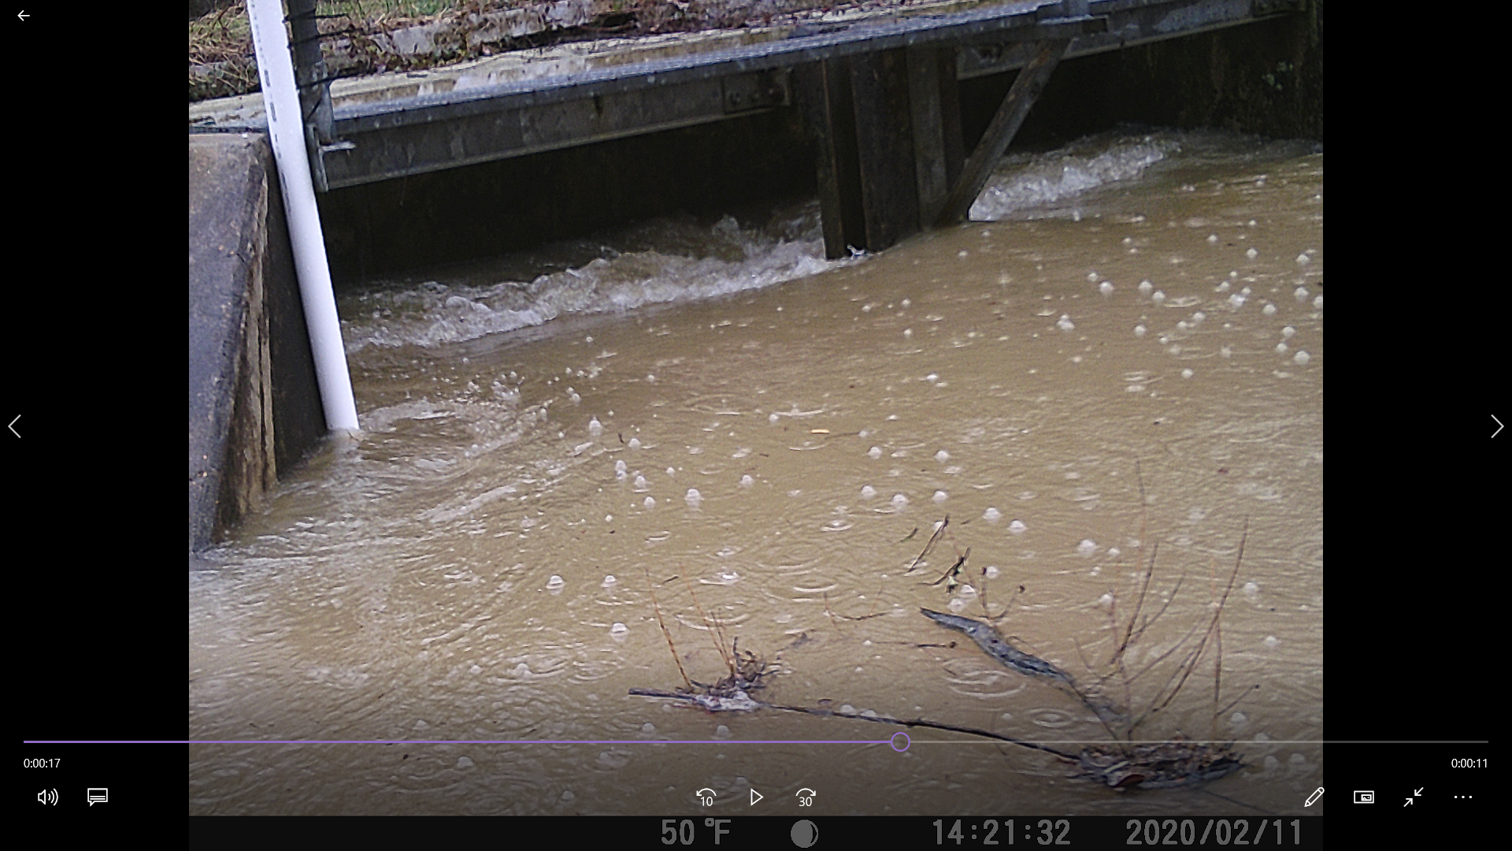
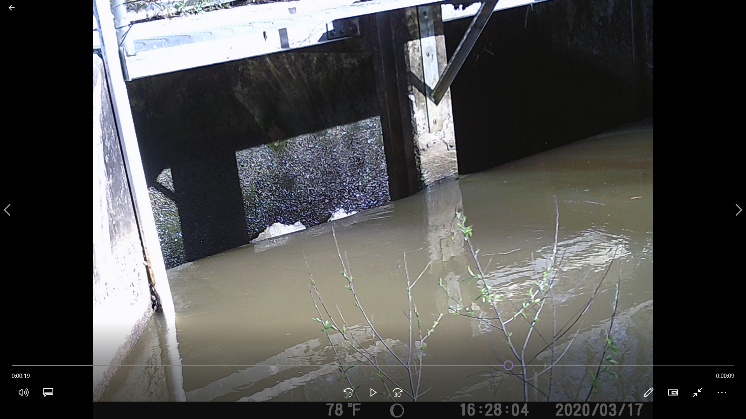
WCS 2
Lake Elevation: 69.605
Noxubee Discharge: 23,200
Lake Elevation: 69.257
Noxubee Discharge: 850
Noxubee River
Noxubee River

Slide 13
WCS 2 Noxubee to Lake Reference 5/20/2020
Levee
216 cm
266 cm
331 cm
431 cm

Slide 14
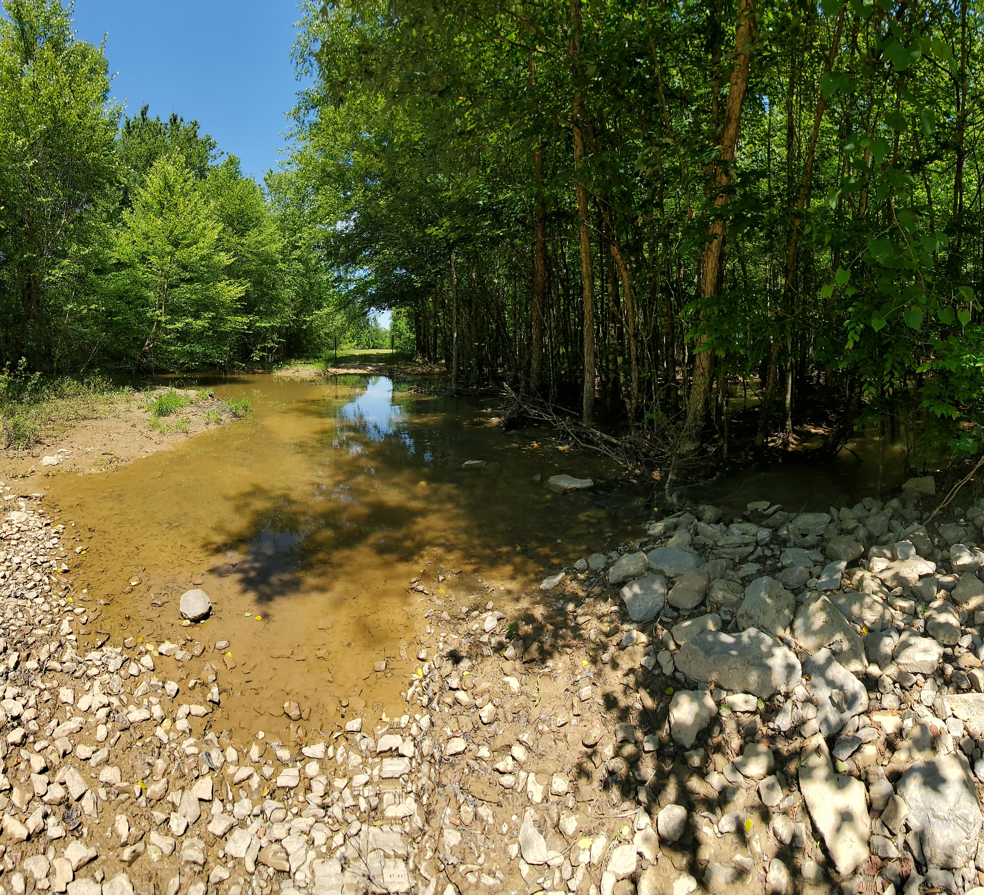
Notch 1
Noxubee River
Bluff Lake
Water continuously flows into Bluff Lake from outer channels of the Noxubee River. This notch leads into shallow braided streams within the boundary of Bluff Lake.
Width at highest point – 34 m
Width at lowest point – 23 m
Depth – 1.2 m

Slide 15
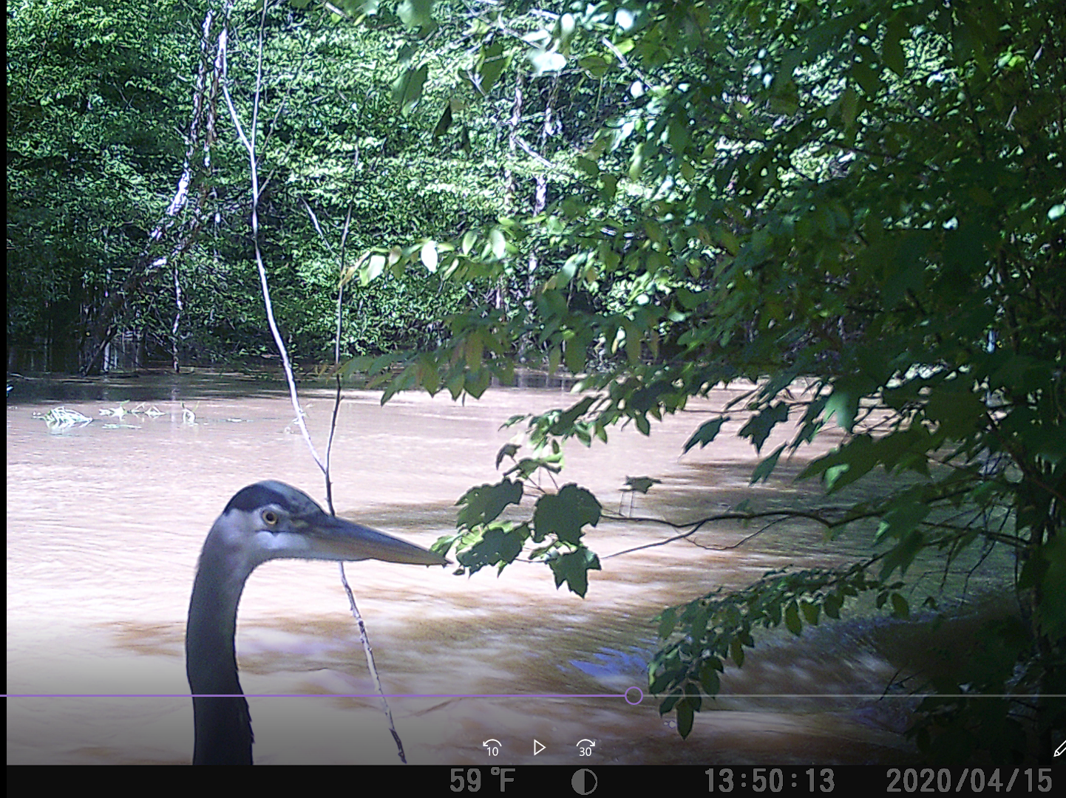
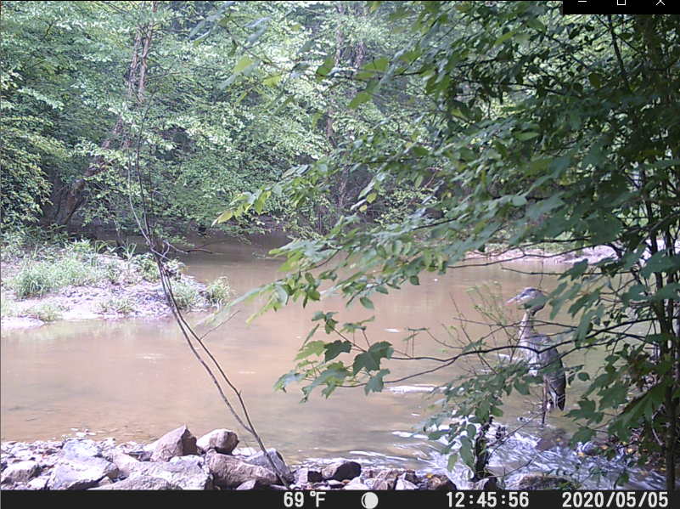
Notch 1
Lake Elevation: 69.786
Noxubee Discharge: 9,950
Lake Elevation: 69.253
Noxubee Discharge: 418
Noxubee River
Noxubee River

Slide 17
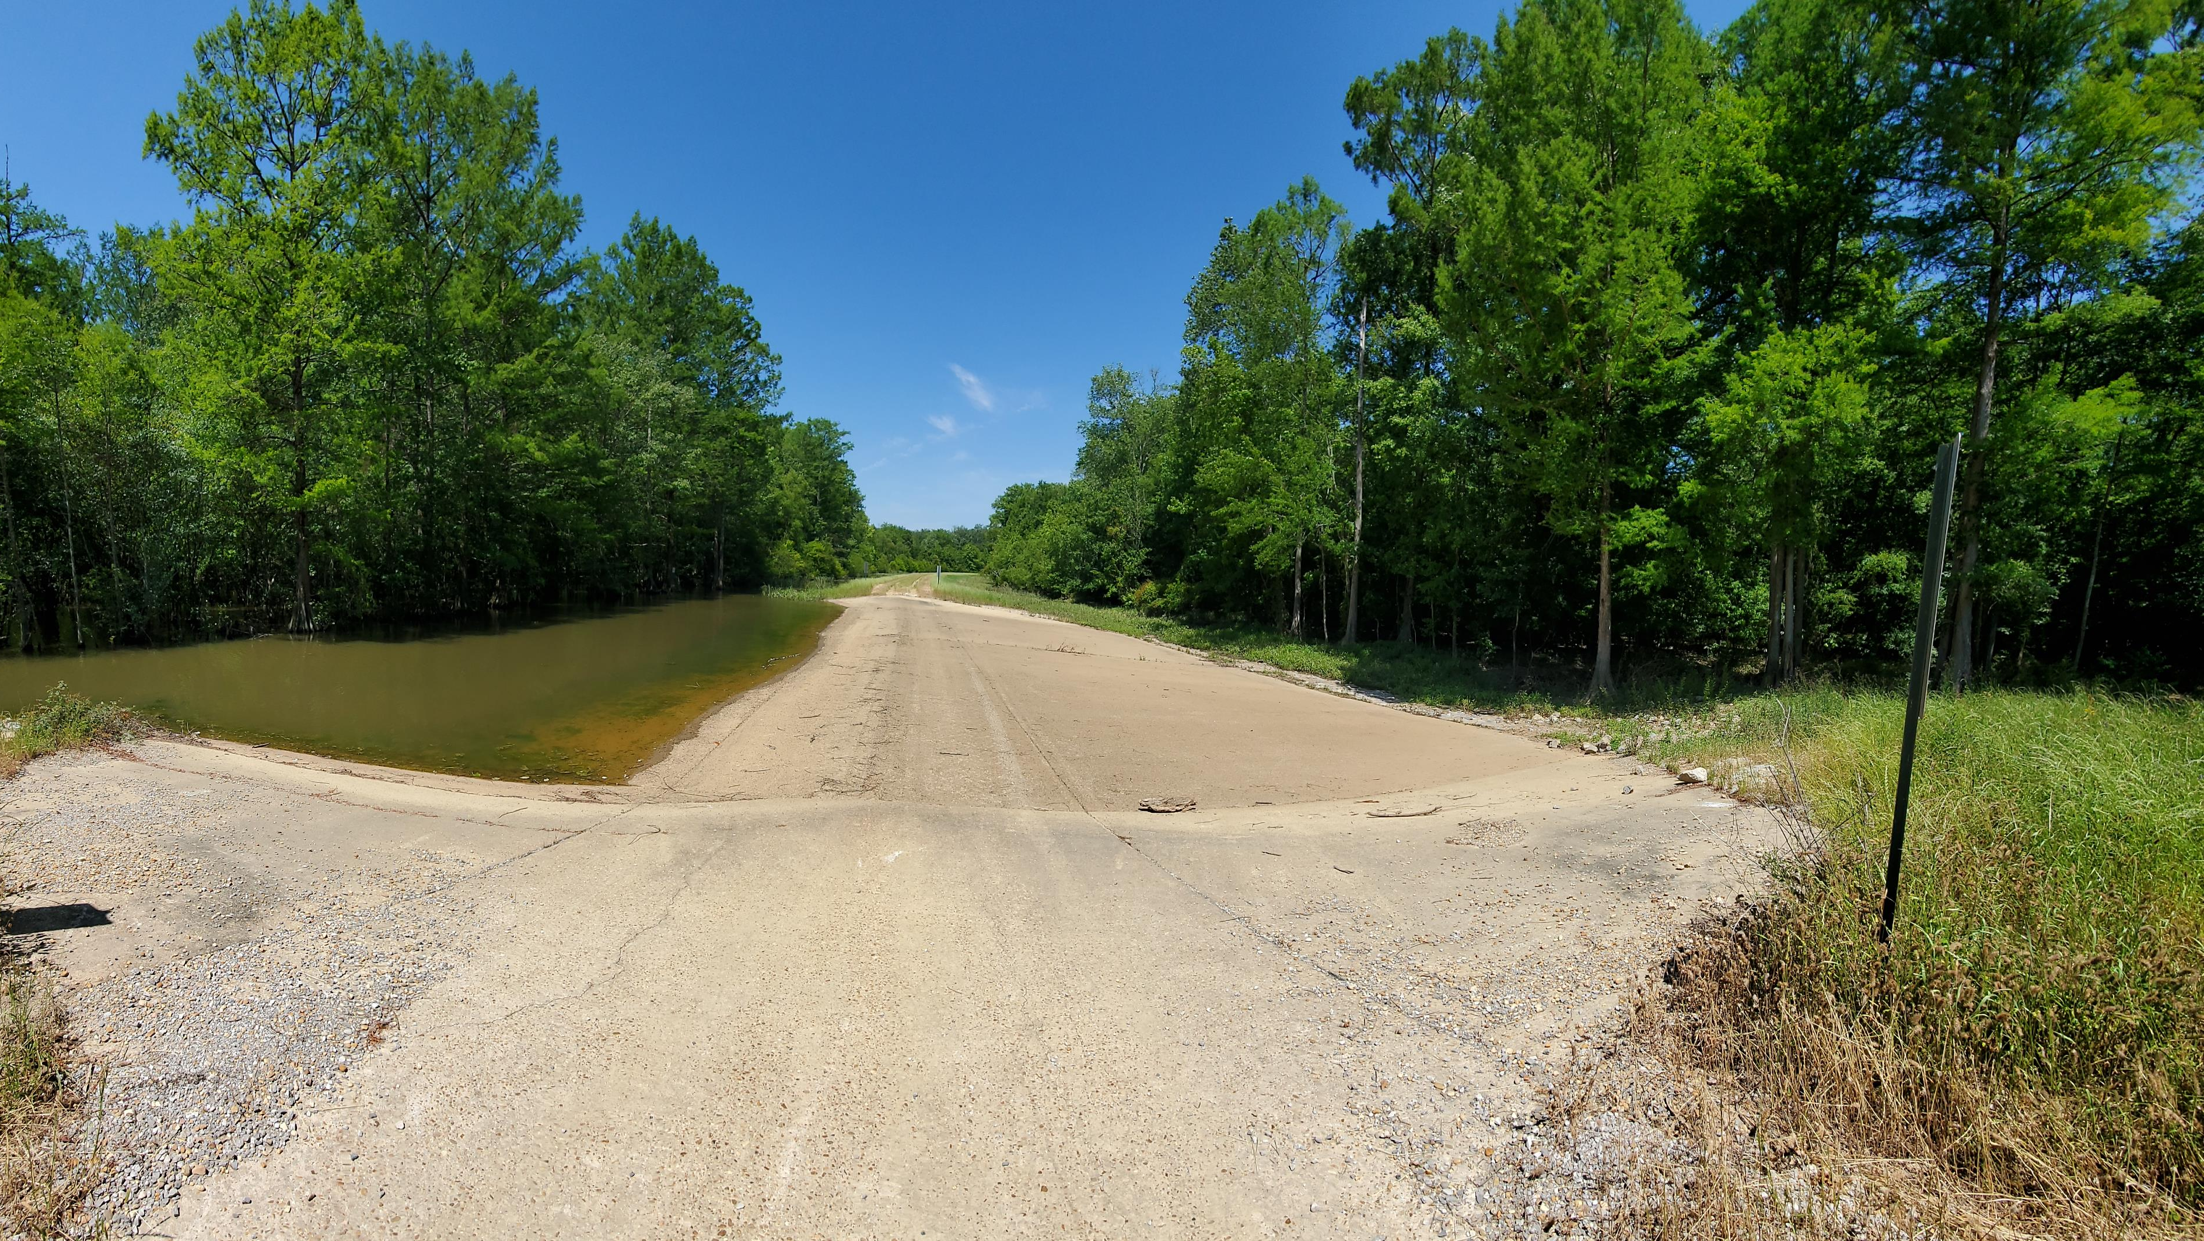
Notch 2
Bluff Lake
Noxubee River
Water levels rise faster on the Noxubee River side causing water to initially flow into Bluff Lake. As lake volume increases and Noxubee River flooding subsides water begins flowing out of Bluff Lake.
Width at highest point – 50 m
Width at lowest point – 35.6 m
Depth – 1 m

Slide 18
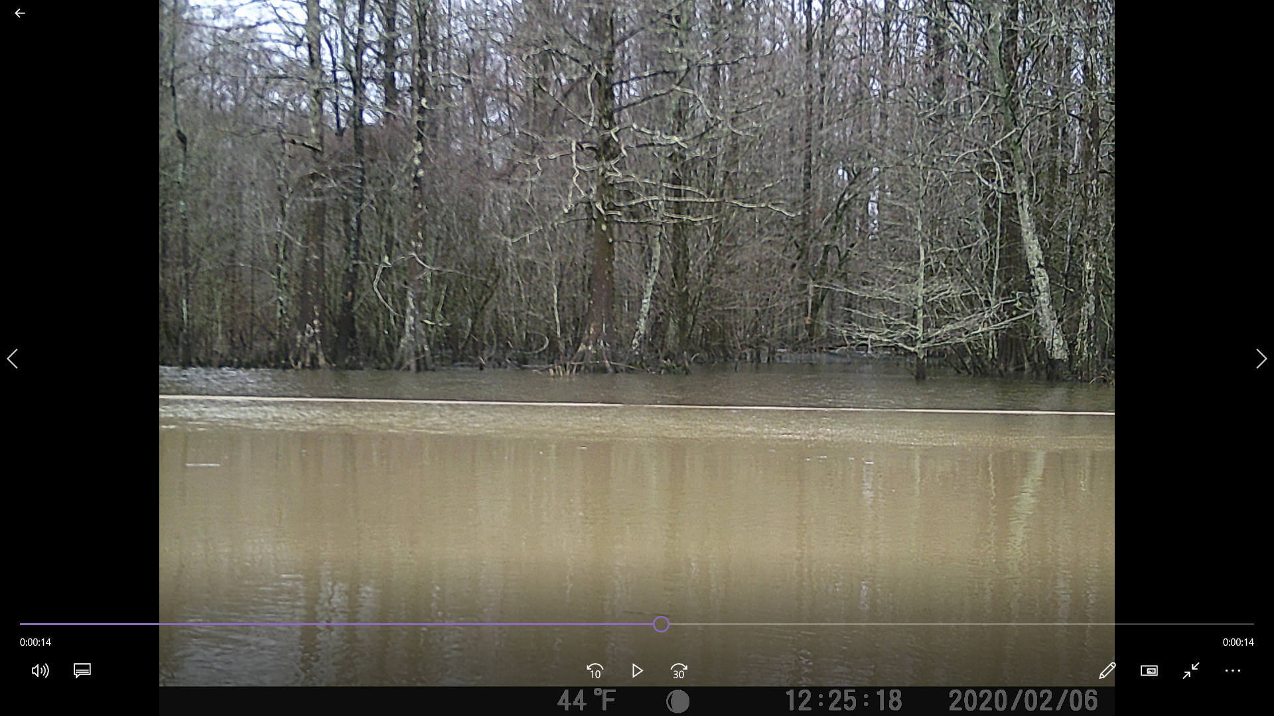
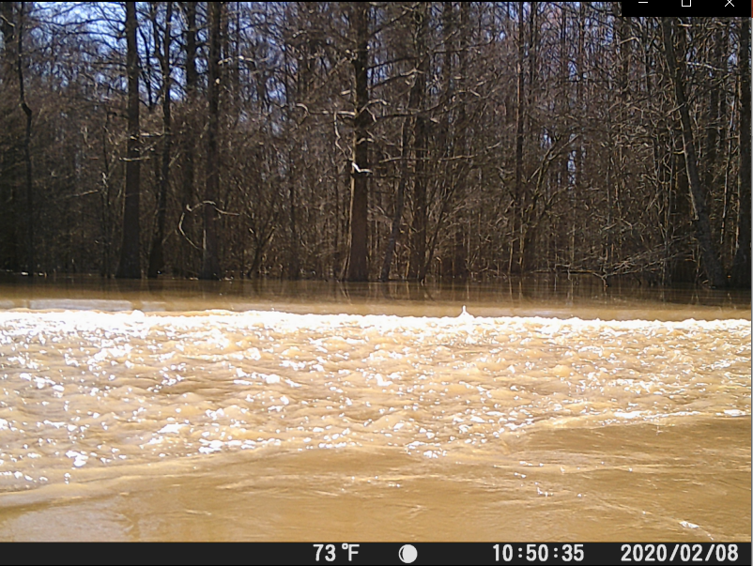
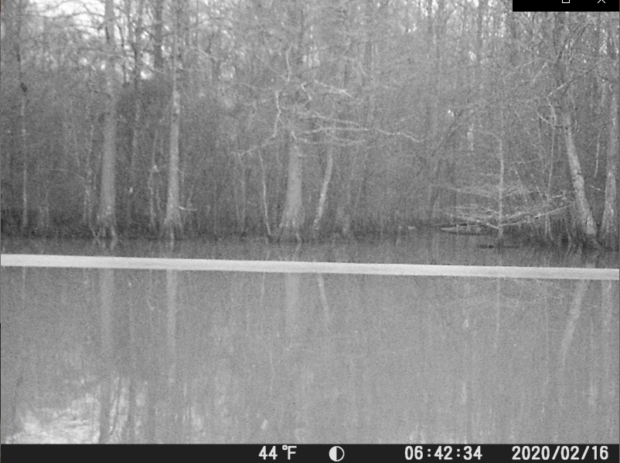
Notch 2
First Connection
Lake Elevation: 68.978
Noxubee Discharge: 3,650
Change in flow direction
Lake Elevation: 69.758
Noxubee Discharge: 4,220
Disconnection
Lake Elevation: 69.302
Noxubee Discharge: 13,500
Bluff Lake
Noxubee River

Slide 20
DISCHARGE

Slide 21
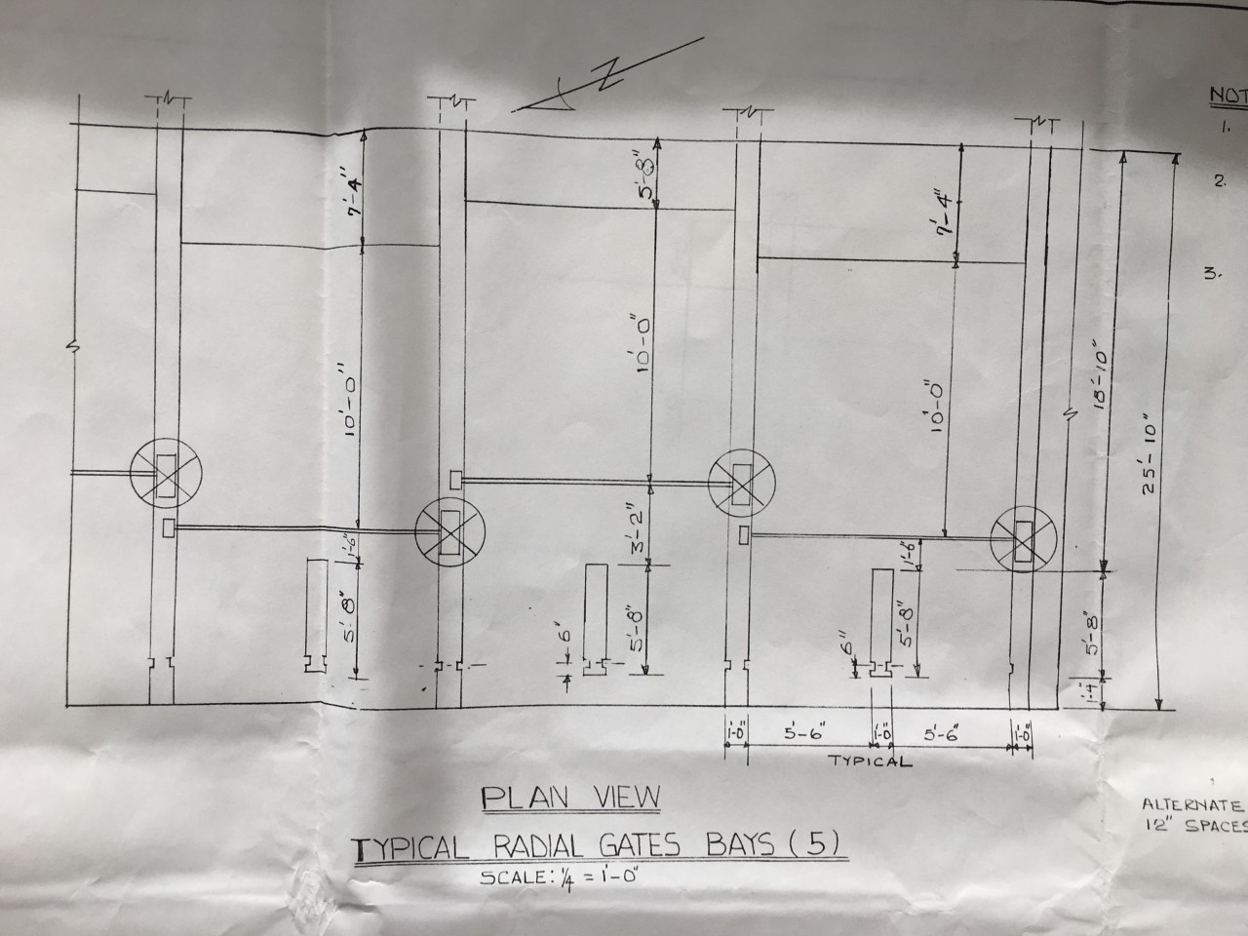
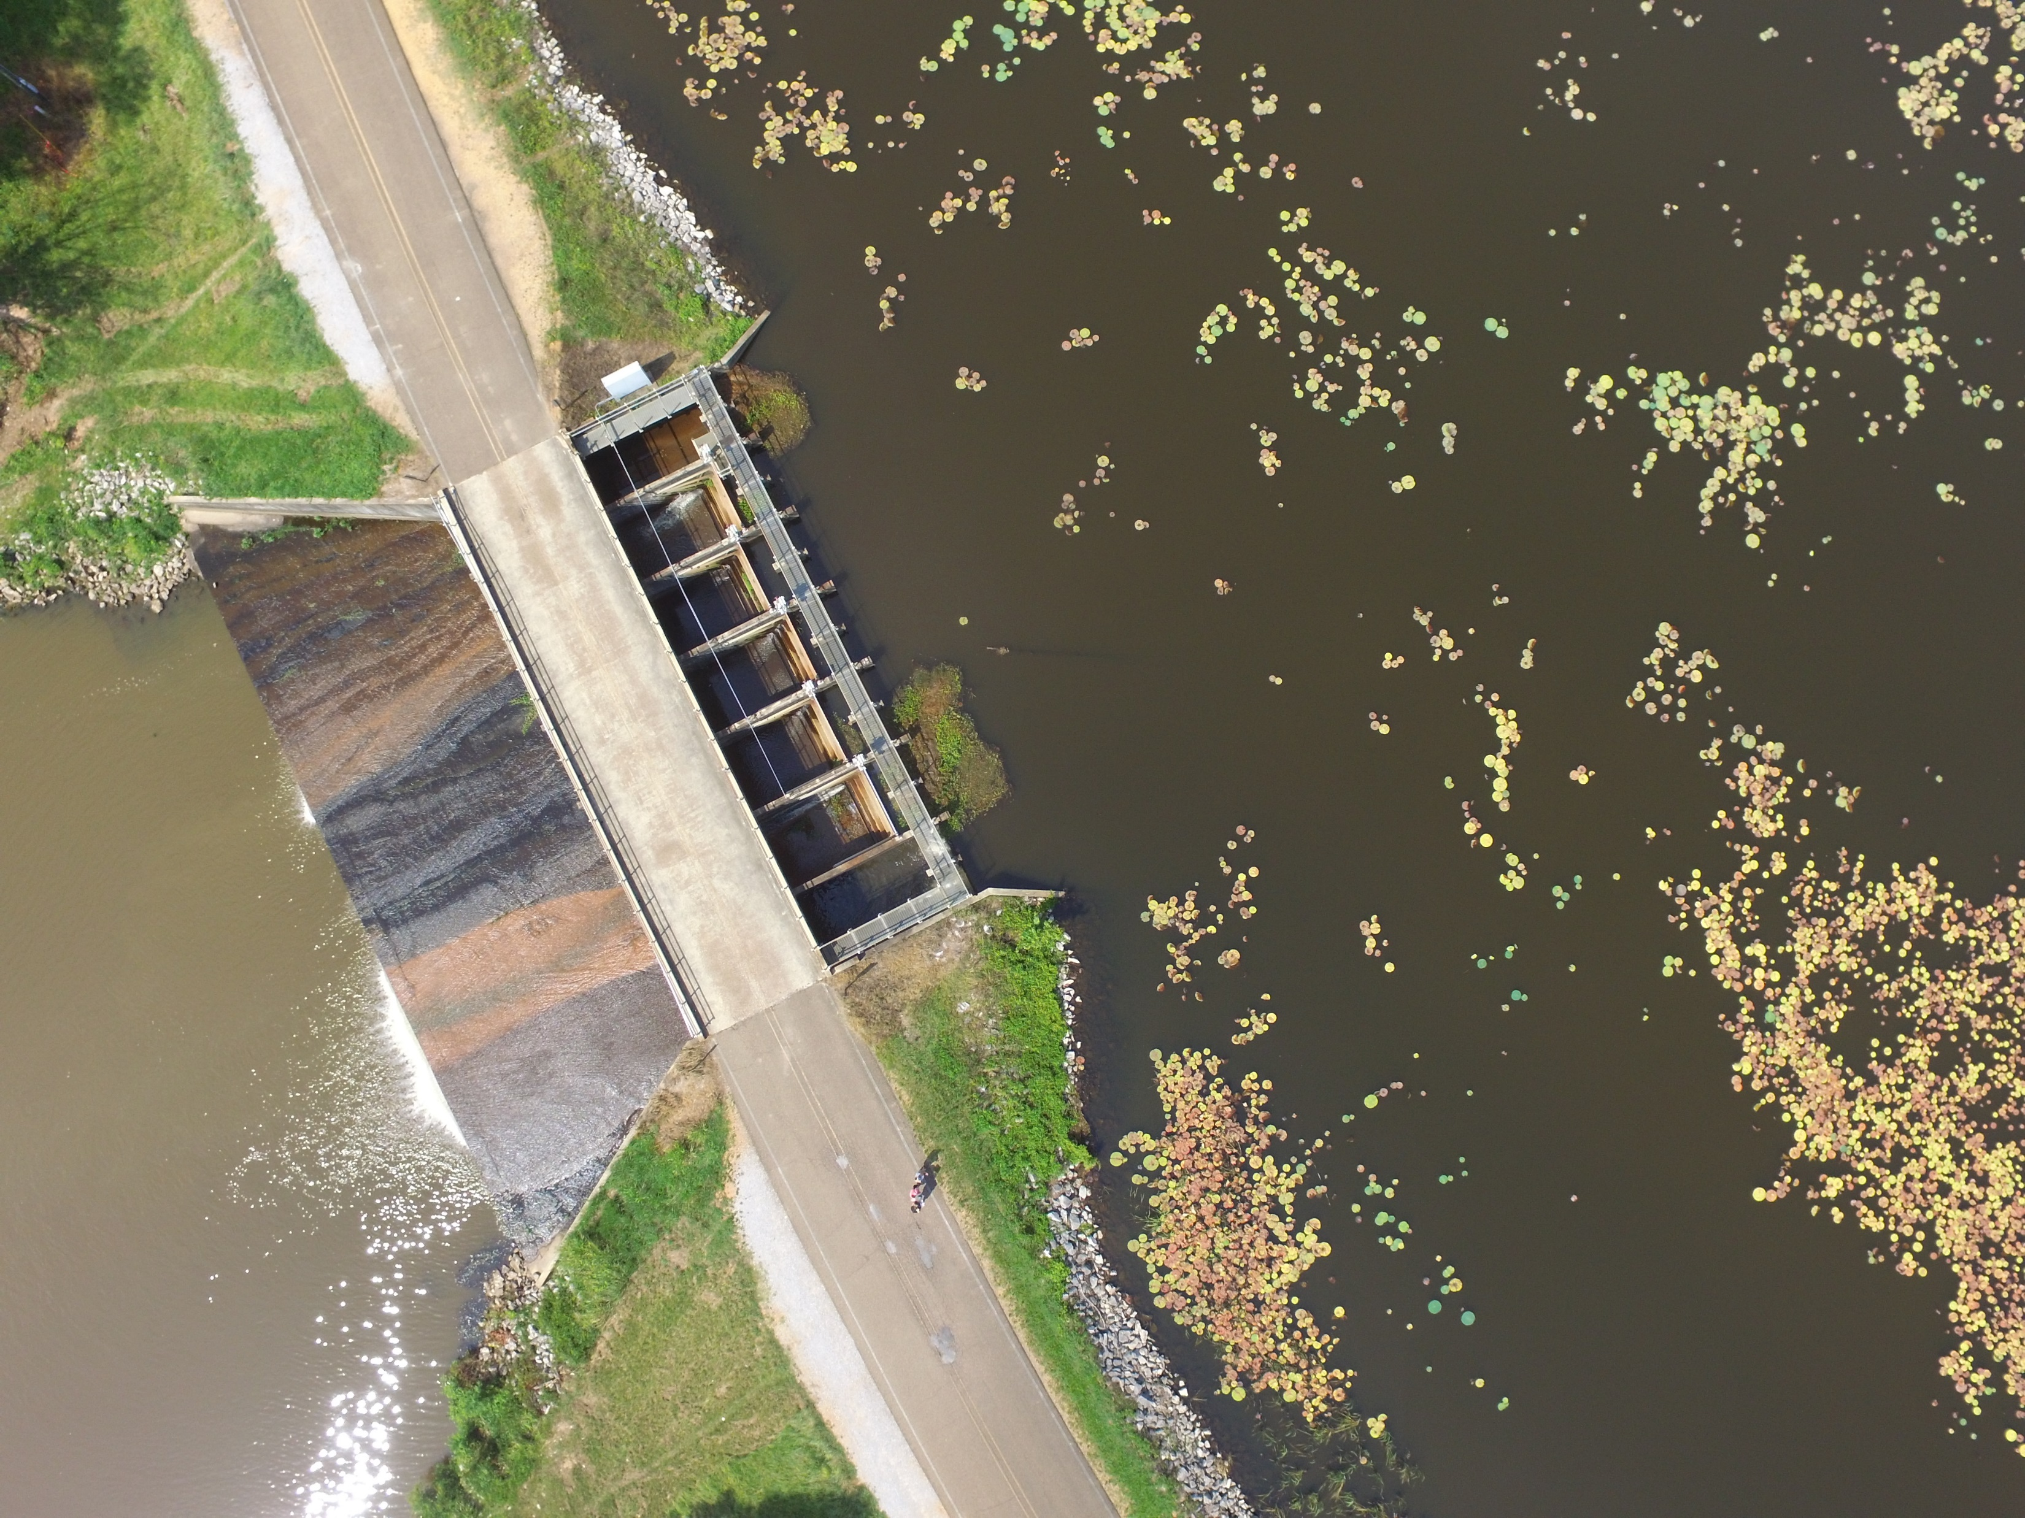
Water Control Structure 1

Slide 22
Board Height | Water Elevation (ft) | Water Elevation (m)
9 | 224.4 | 68.39712
8 | 223.8 | 68.21424
7 | 223 | 67.9704
6 | 222.2 | 67.72656
5 | 221.6 | 67.54368
Chart provided by the USFWS.
Boards are actually 8 in/20.32 cm

Slide 23
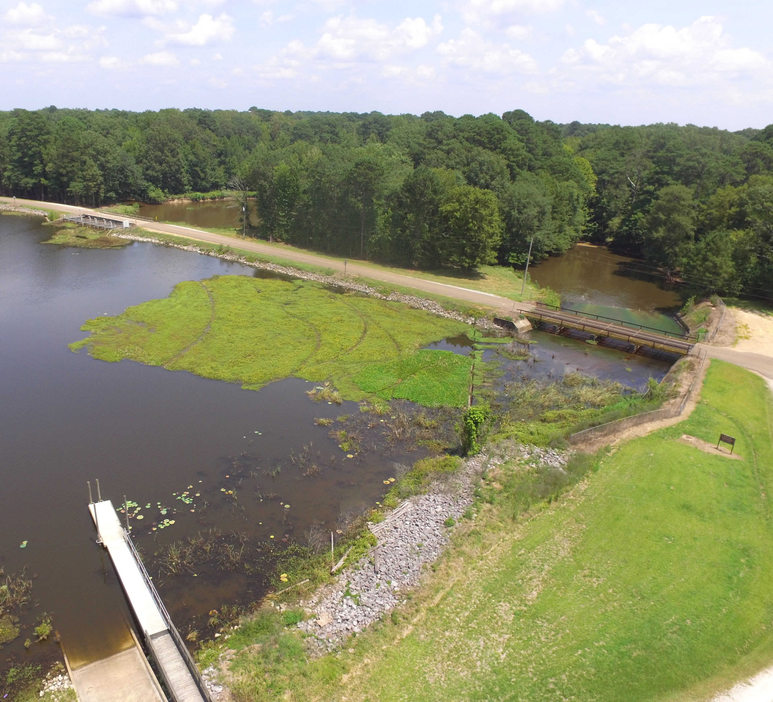
Emergency Spillway

Slide 24
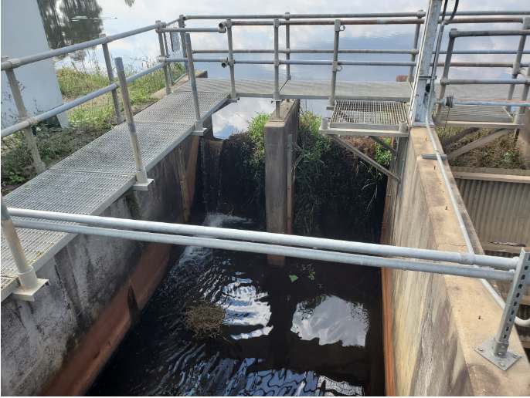
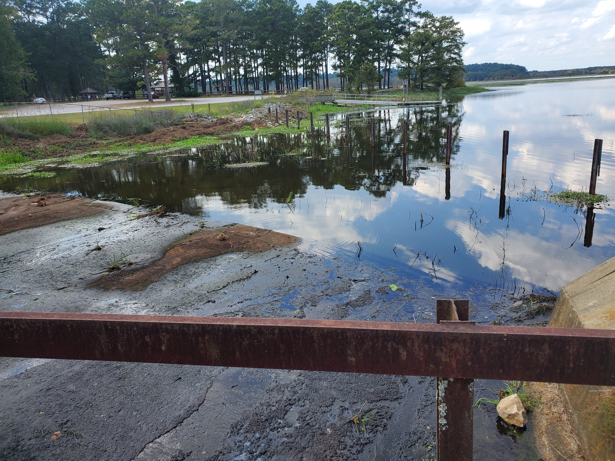
Lake Elevation: 68.39712
Pictures taken on same day. Reference water level above boards.

